Slide 1

Joy Makers
Monalika Pradhan
Krishnanand Jha
Mrinalini Jadhav

Slide 2
Introduction
Joy Makers is a NGO Management System where the NGO is connected to different organizations that help the children in overall development.
The main focus for developing the project was to provide a platform wherein different organizations can get associated with each other and contribute to a social cause.
The system consists of Networks which are indeed associated with organizations like Doctors, Volunteers, Storage, Tutor and Storage.
The children are made available with all facilities through this system. Also the medicines and food is handled by the transportation organization.

Slide 3
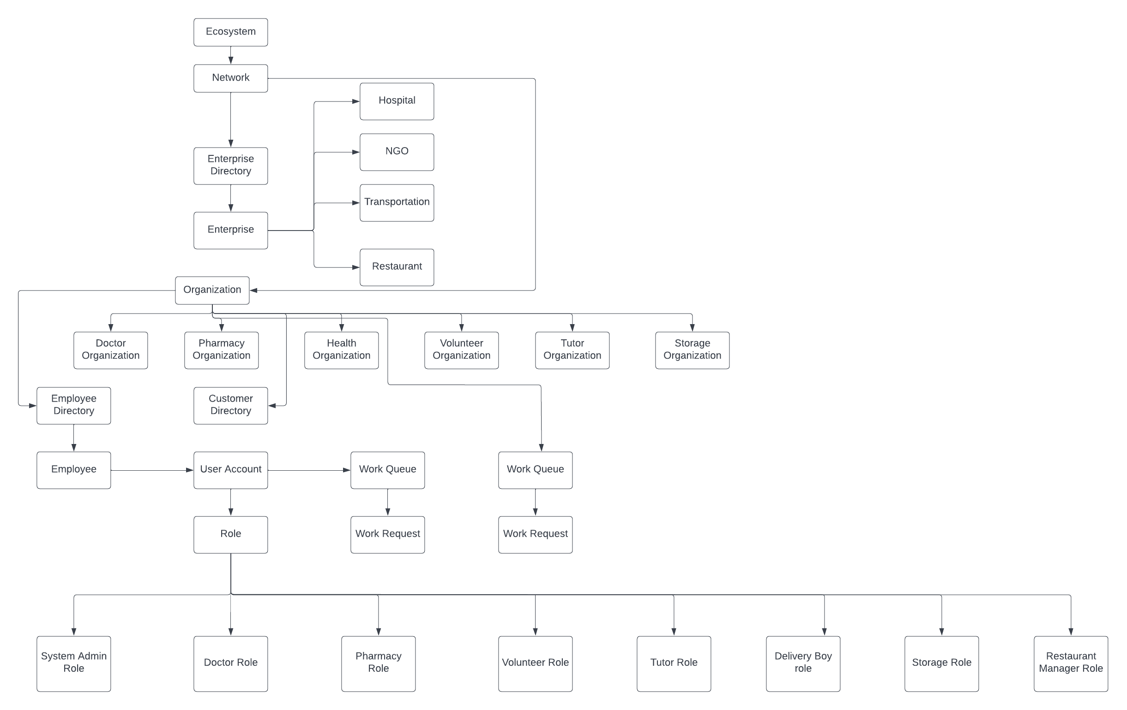
Architecture Diagram

Slide 4
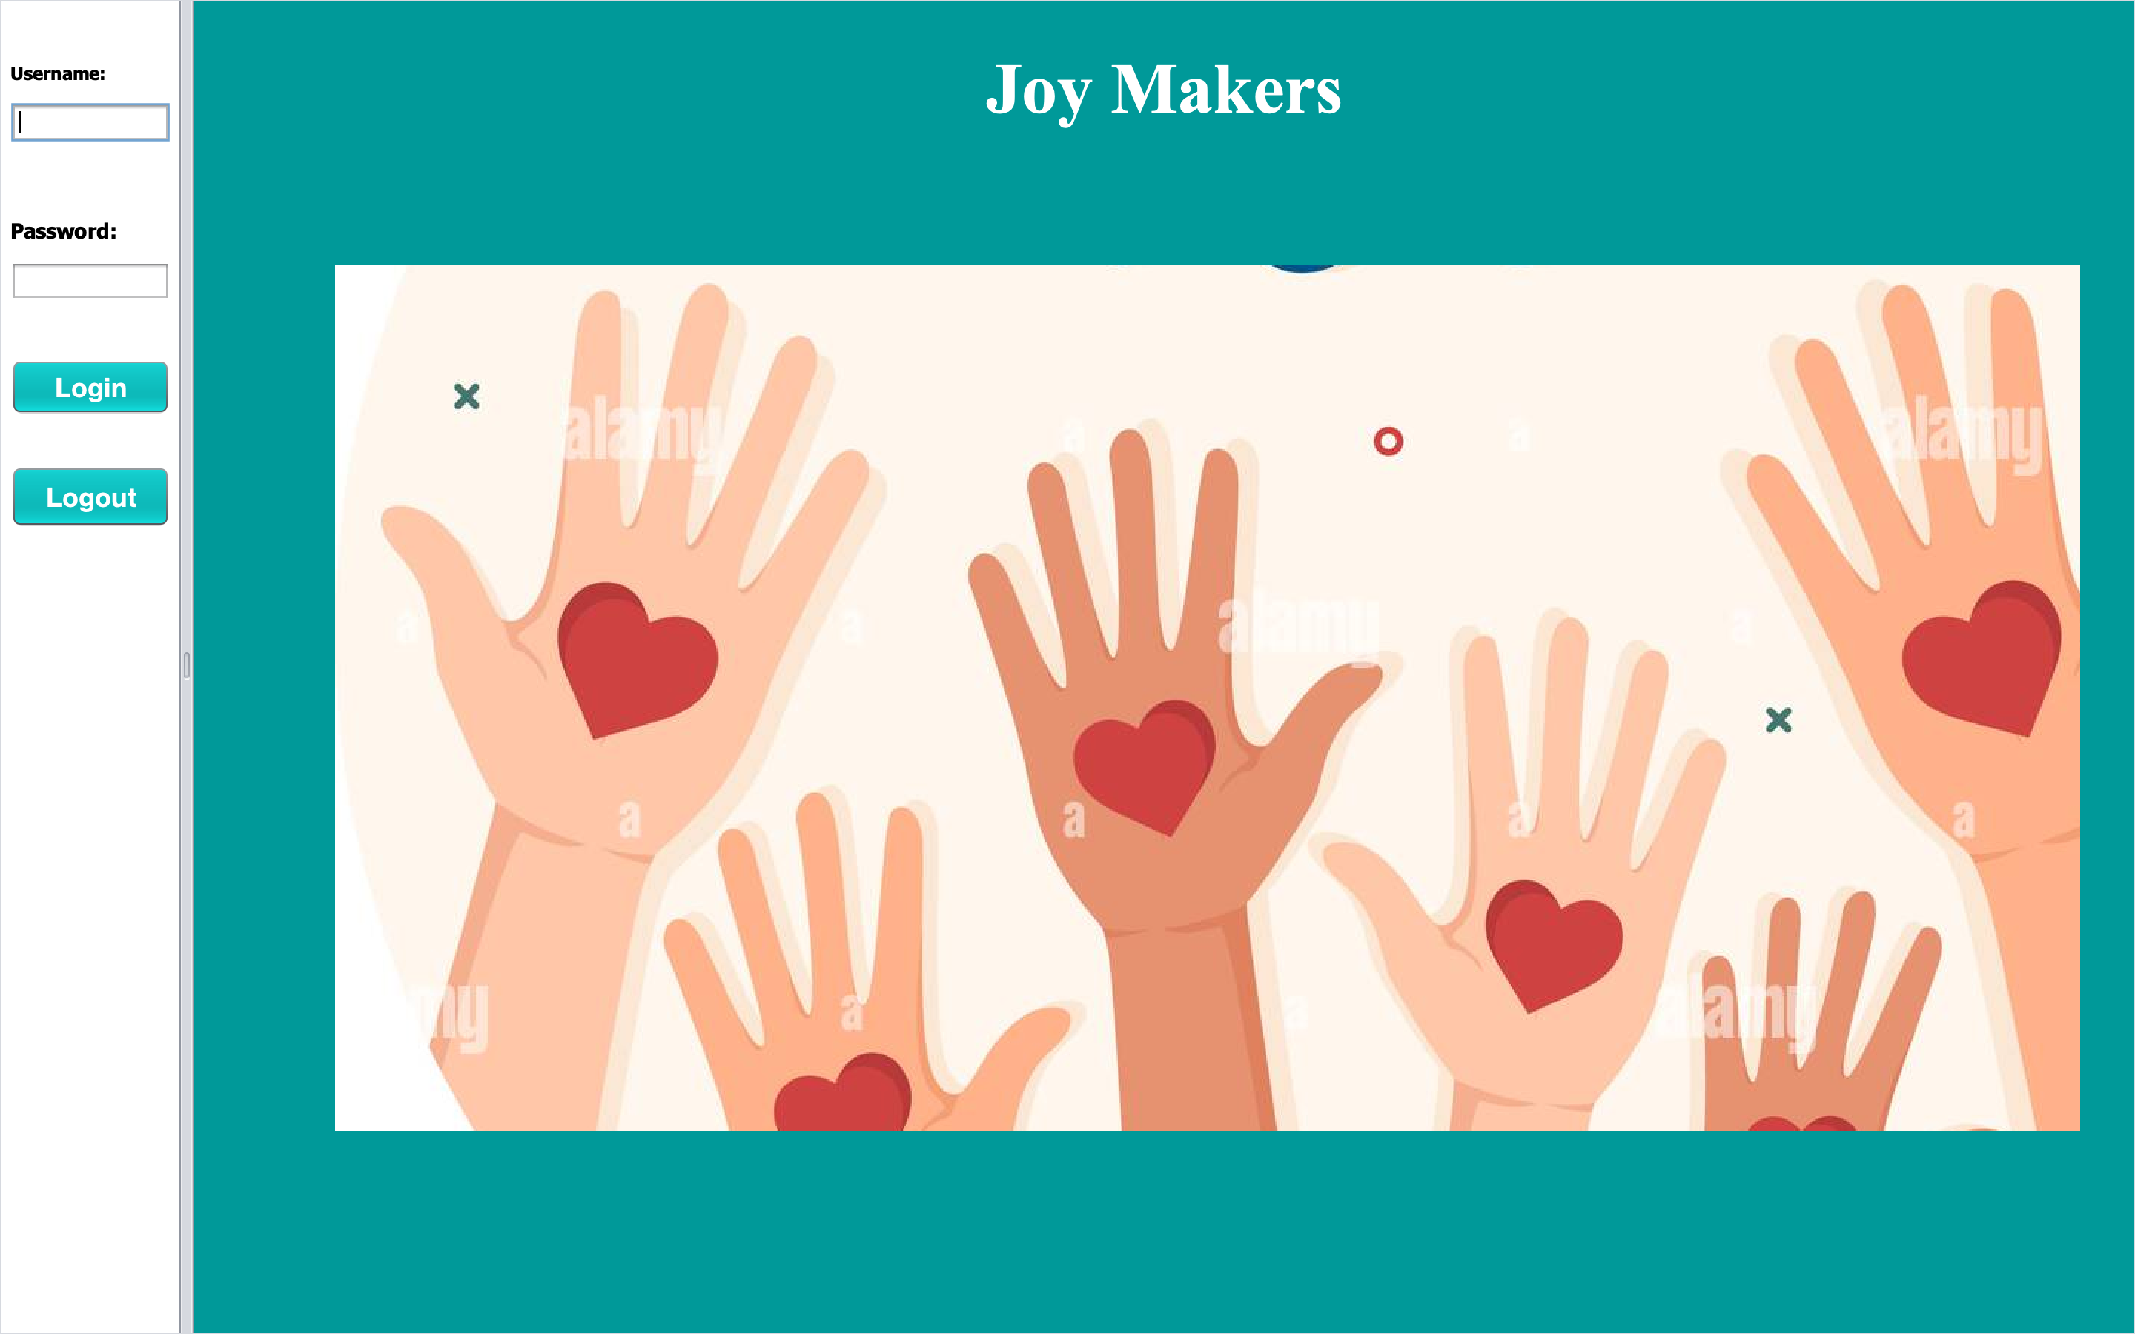
Screenshots

Slide 5
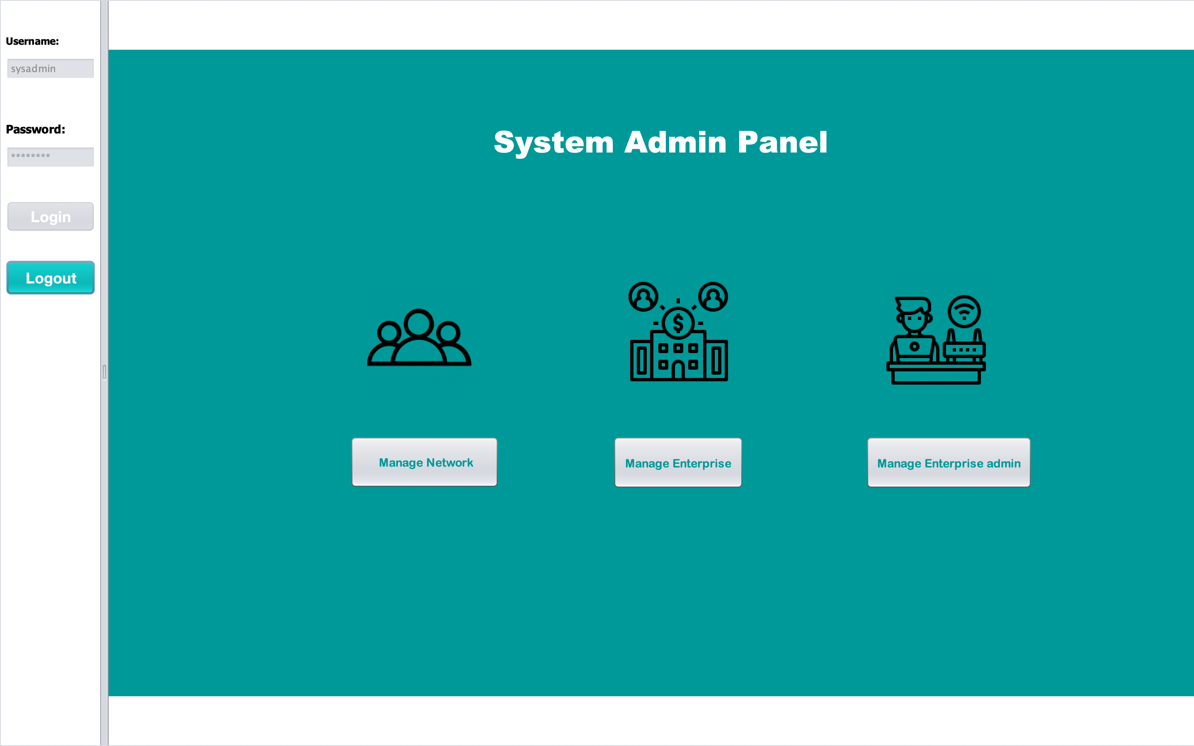
System admin panel

Slide 6
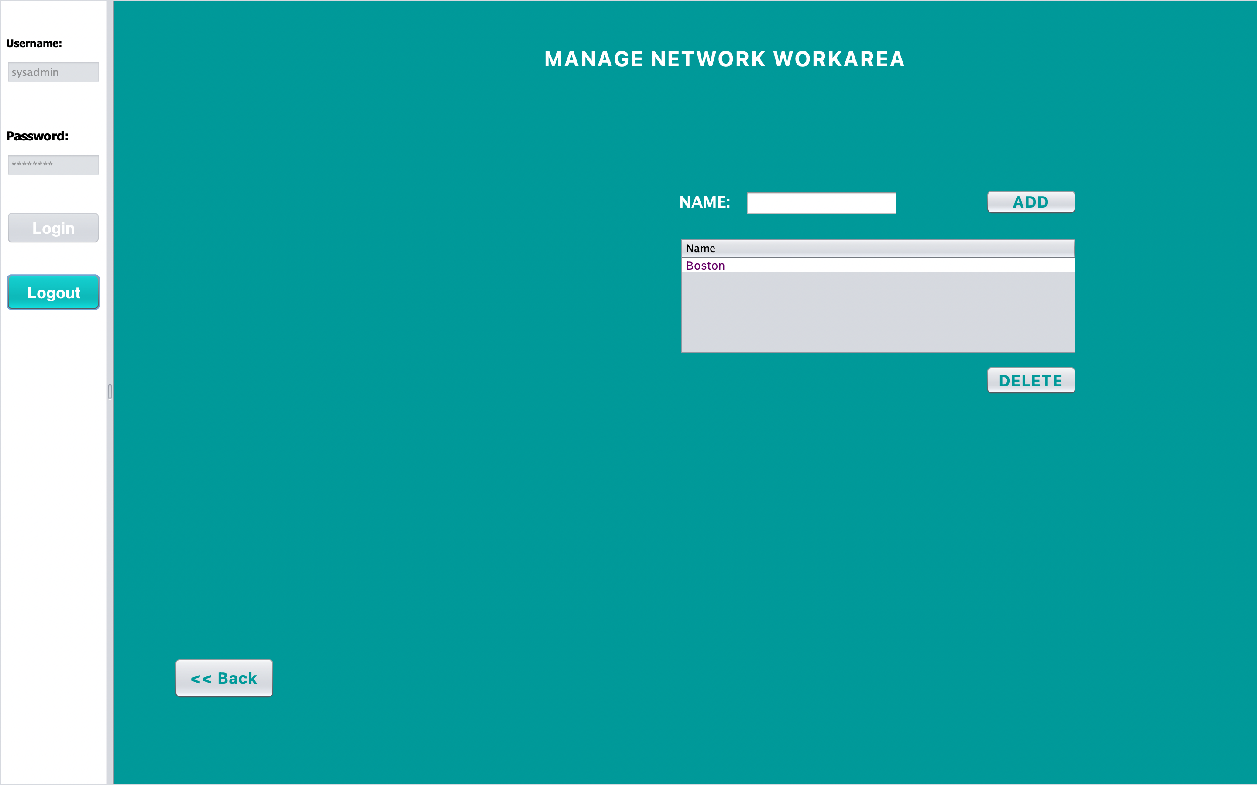
Manage network work area

Slide 7
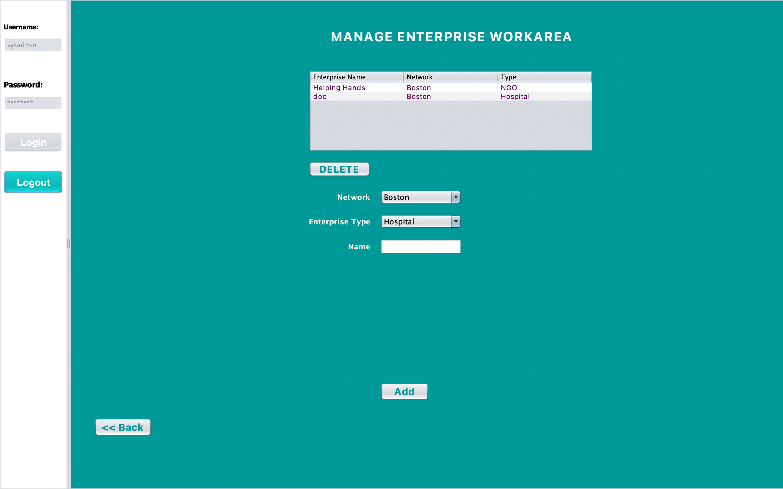
Manage Enterprise Work Area

Slide 8
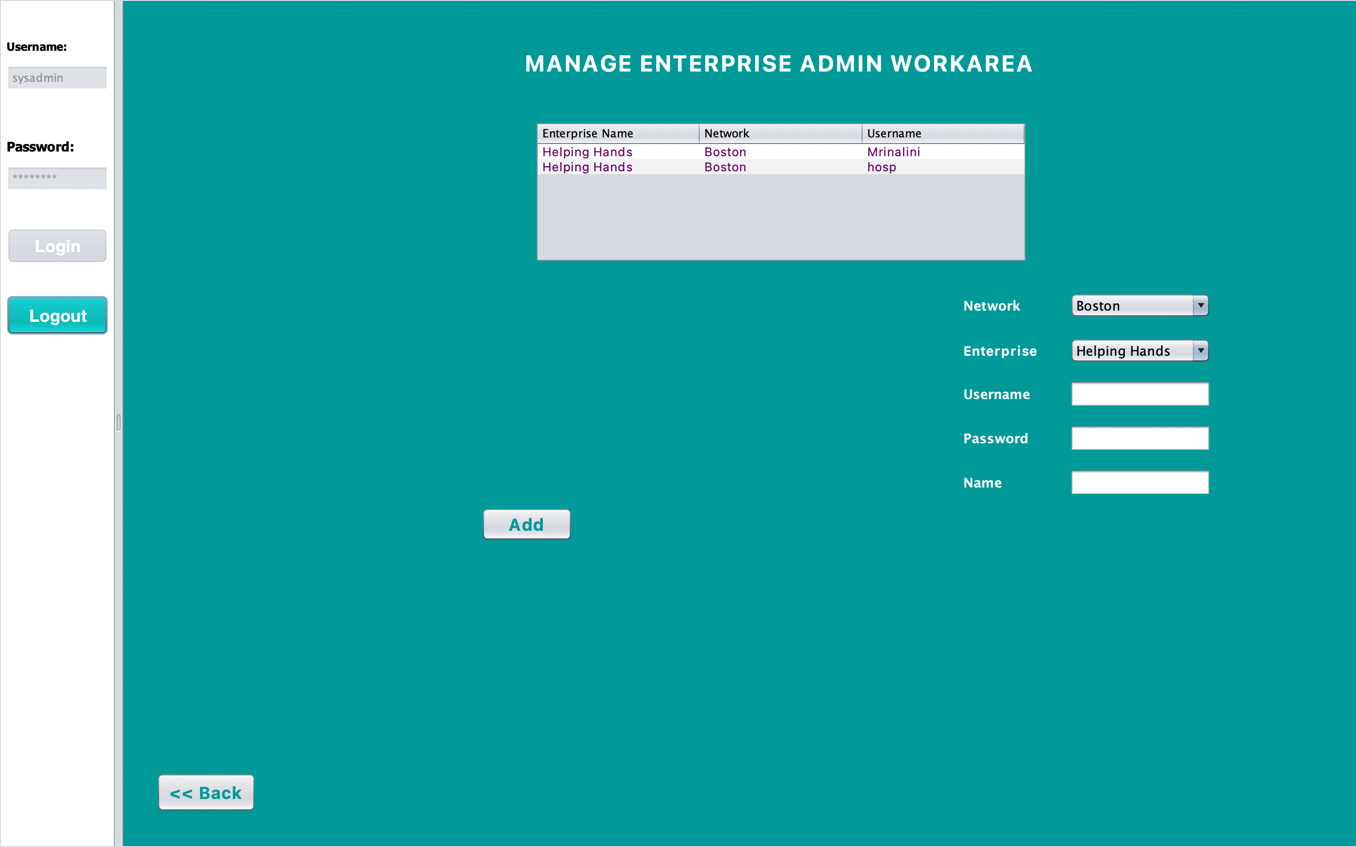

Slide 9
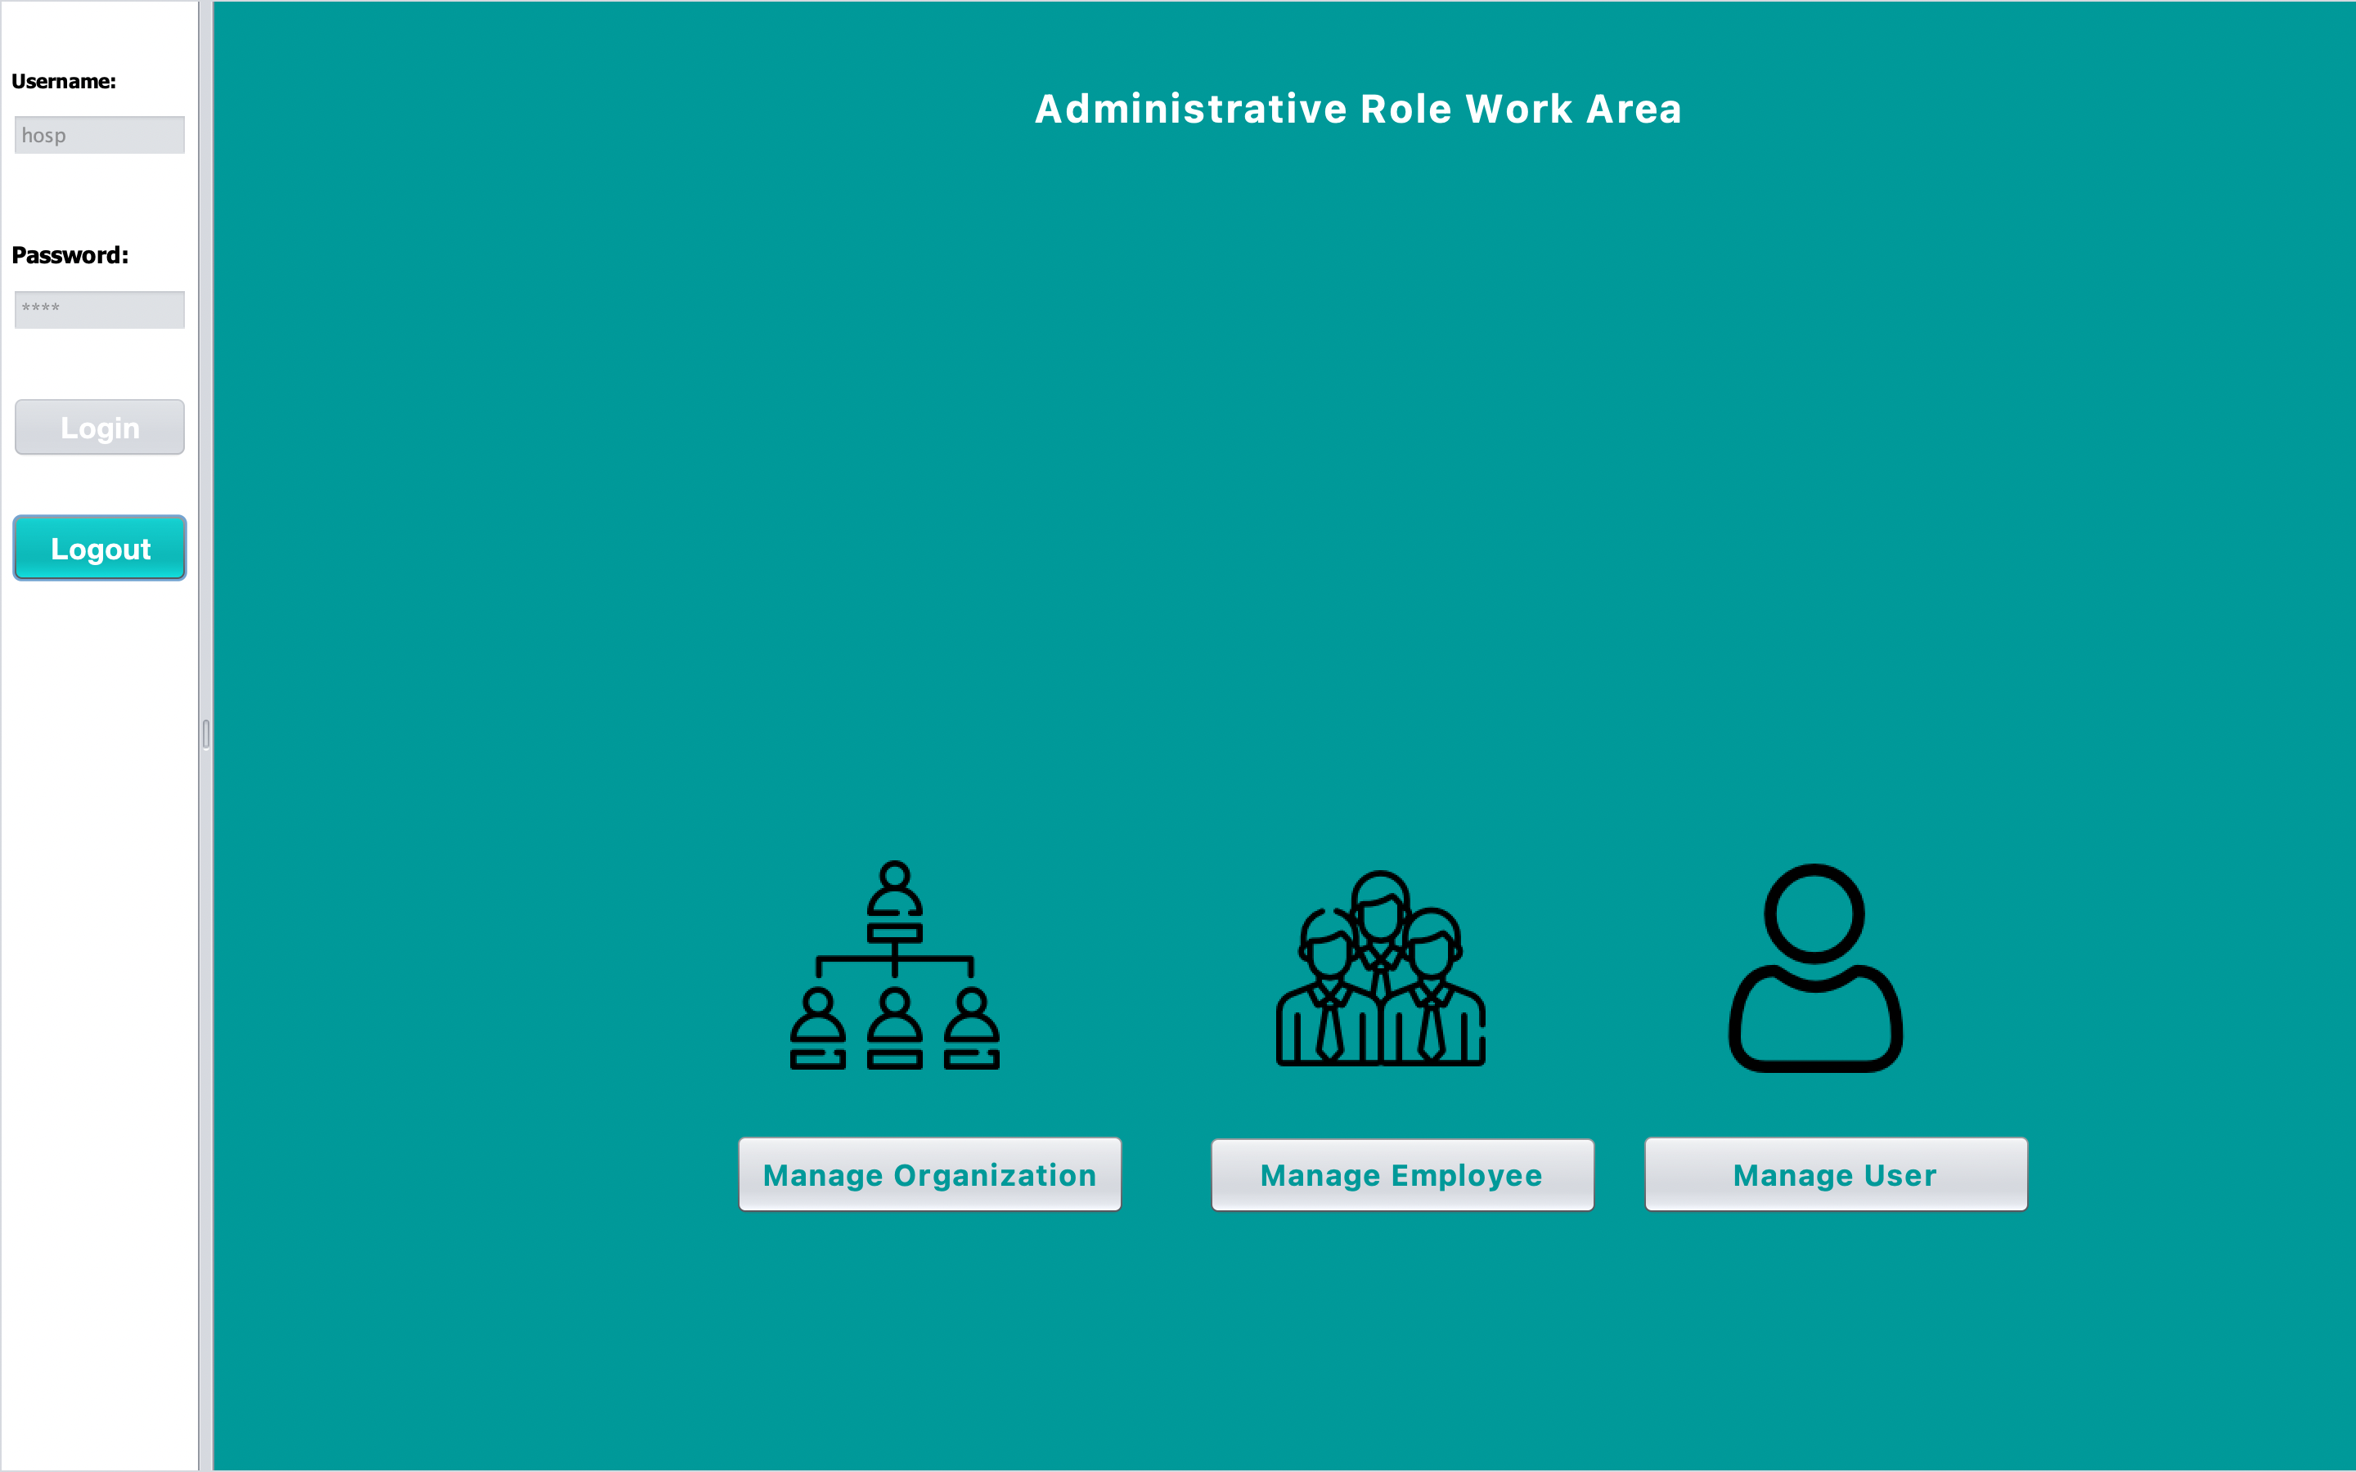
Administrative Role Work Area

Slide 10
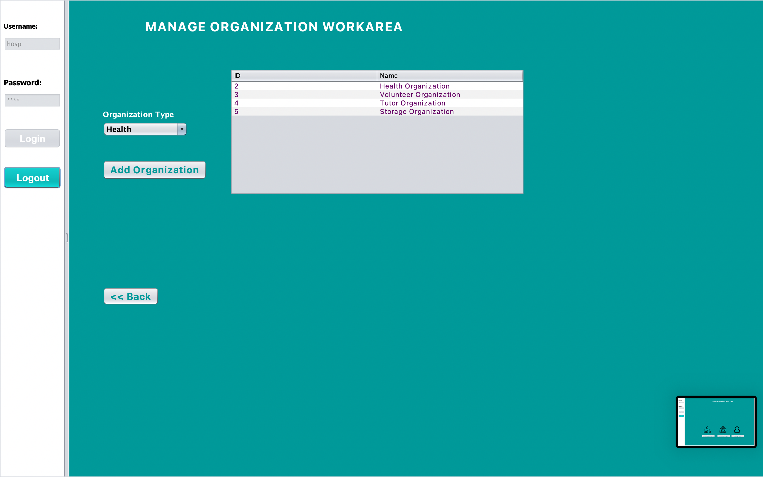
Manage Organization Work Area

Slide 11
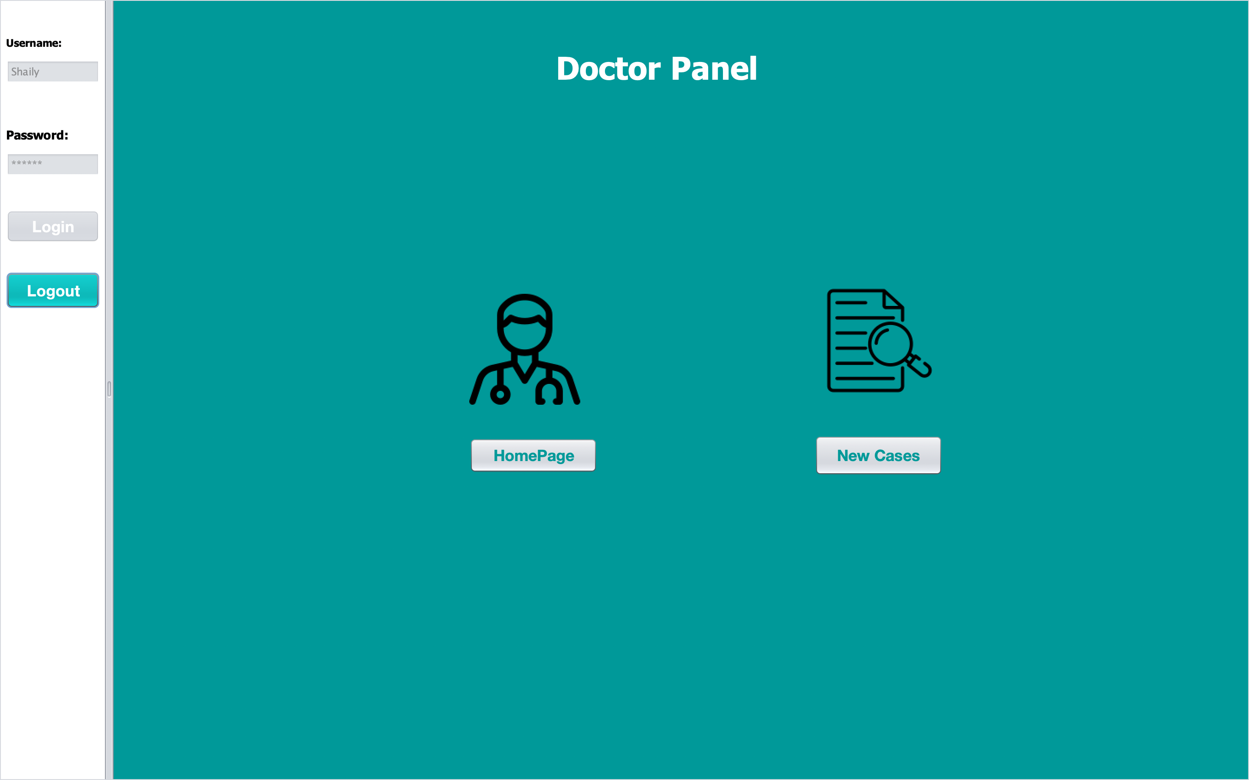
Doctor Panel

Slide 12
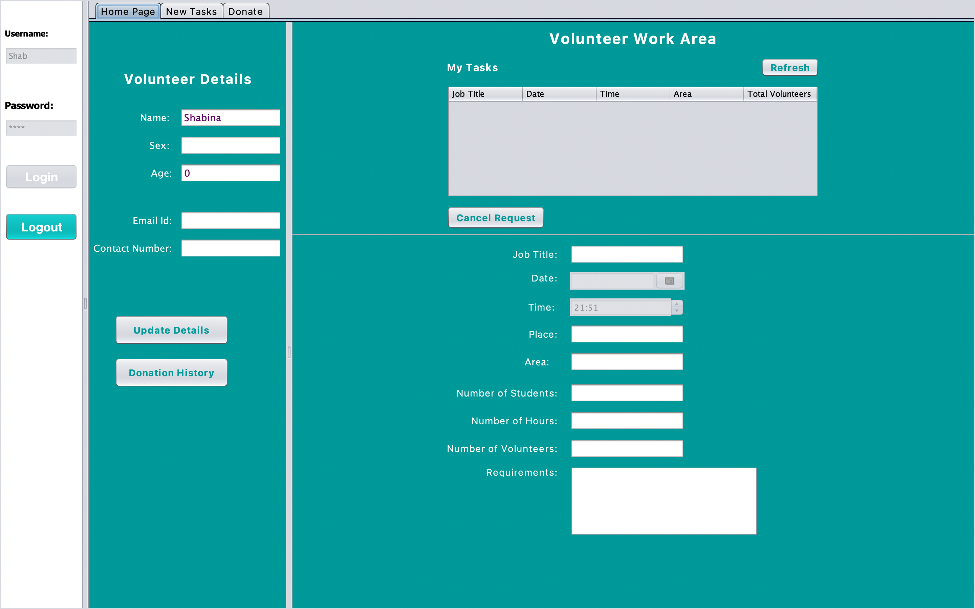
Volunteer Work Area

